Slide 1
9_Chapter 9, Part 3B
Variable Selection Methods

Slide 2
The Partial F-Test
Some selection methods use partial F-Test
Suppose model has x₁,…,x_{p} predictors and we consider adding additional predictor x* (example: x₁ = sugars and x₂ = fiber; want to add x* = shelf1)
Now, we calculate sequential sum of squares from adding x*, given existing x₁,…,x_{p} in model (example: fit model with sugars, fiber, and shelf1)
Full sum of squares SS_{Full} = x₁,…,x_{p,} x* in model (SSR for model with sugars, fiber, shelf1)
Reduced sum of squares SS_{Reduced} = x₁,…,x_{p} in model (SSR for model with sugars and fiber)
Therefore, extra sum of squares SS_{Extra} denoted by

Slide 3
The Partial F-Test (cont’d)
Null hypothesis for Partial F-Test
Ho: No, SS_{Extra} associated with x* does not contribute significantly to model
Ha: Yes, SS_{Extra} associated with x* does contribute significantly to model
Test statistic for Partial F-Test follows F_{1, n-p-2} distribution when Ho true
Therefore, Ho rejected for small p-value
Equivalent to t-tests for individual coefficients: F_{1, n-p-2} = (t_{n-p-2})²

Slide 4
Forward Selection Procedure
Procedure begins with no variables in model
Step 1:
Predictor x₁ most highly correlated with response selected (or largest R²)
If model not significant, stop and report no predictors important
Otherwise, proceed to Step 2
Step 2:
For remaining predictors, compute sequential F-statistic given predictors already in model
For example, first pass sequential F-Statistics computed for F(x₂|x₁), F(x₃|x₁), F(x₄|x₁)
Select variable with largest sequential F-statistic (this will have to smallest p-value)
Step 3:
Test significance of sequential F-statistic, for variable selected in Step 2
If resulting model not significant, then stop and report model without variable
selected in Step 2
Otherwise, add variable from Step 2, and return to Step 2 to add another variable.

Slide 5
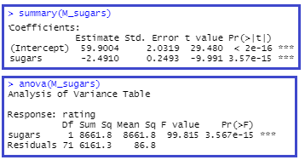

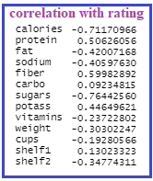


Apply Forward Selection to Cereals
Before we get started, we can use the correlation table to decide which variable goes in first.

Slide 6
Forward Selection Applied to Cereals Data Set
We estimate rating based on 12 predictors
Best model should not exclude significant predictors
This procedure starts with no variables in model
Sugars has highest correlation (r = – 0.764) with rating, among predictors, and is significant. So, we put sugars in the model.
Next, sequential F-tests are performed with the remaining 11 predictors.
Highest sequential F-statistic given by F(fiber | sugars). So, fiber is second predictor entered in model.
Continue.

Slide 7
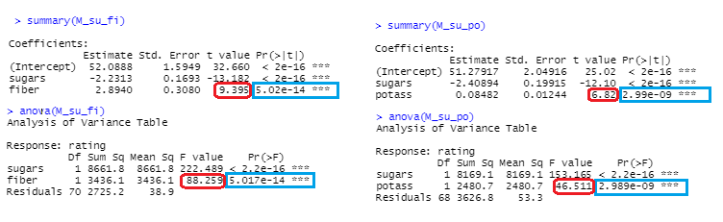
Check two variables: fiber and potass (for demonstration)
Compare

Slide 8
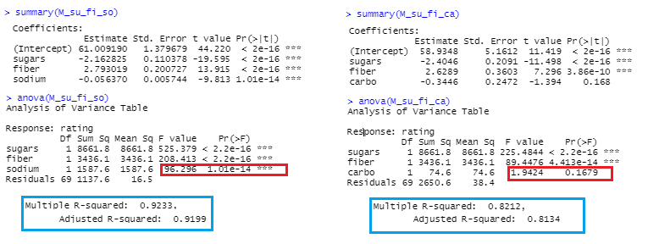

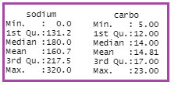
Check two more variables after having added sugars and fiber: sodium and carbo (for demonstration)

Slide 9
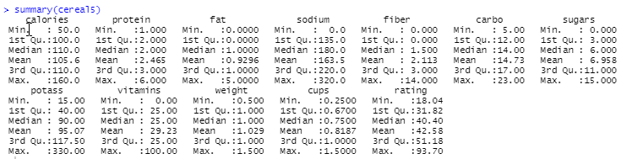
Now it’s time to automate the process!
I used data frame cereal5 (missing values removed, didn’t include shelf2); 11 predictor variables and one target variable (12th position)

Slide 10
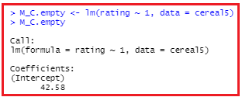
Start with the intercept only model; Add one variable at a time
install.packages("MASS")
library(MASS)
Intercept-only model

Slide 11
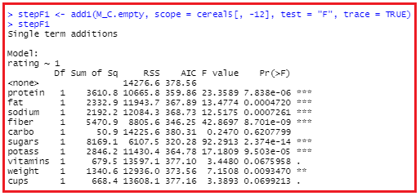
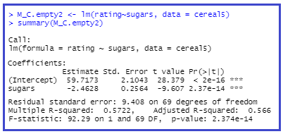
Step 1

Slide 12
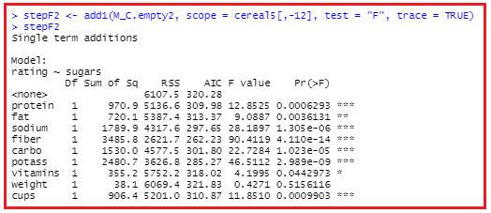

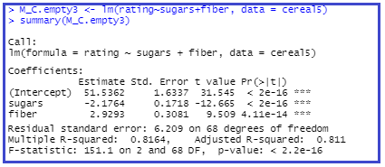
Step 2

Slide 13
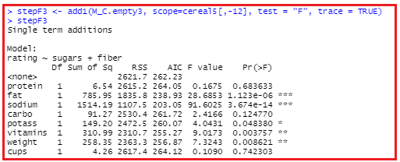
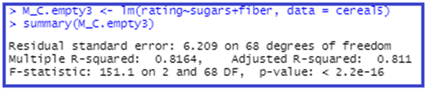
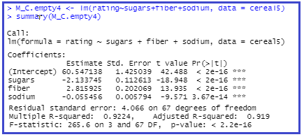
Step 3

Slide 14
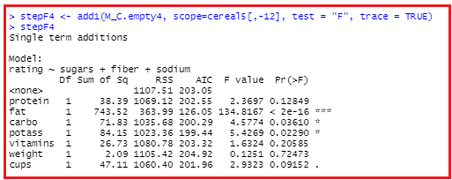

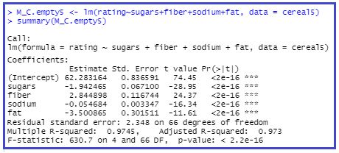
Step 4

Slide 15
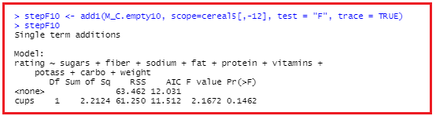
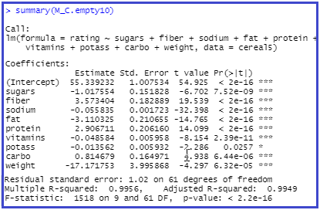
Step 10

Slide 16
AIC (Akaike Information Criterion) – instead of F
What is AIC in stepwise regression?
AIC is an estimator of in-sample prediction error and is similar to the adjusted R-squared measures we see in our regression output summaries. It effectively penalizes us for adding more variables to the model. Lower scores can indicate a more parsimonious model, relative to a model fit with a higher AIC.
Back <- lm(rating~sugars+fiber+potass+carbo+weight+fat+cups+sodium+calories+protein, data = cereal5)
Stepback <- stepAIC(Back, direction = "backward")

Slide 17
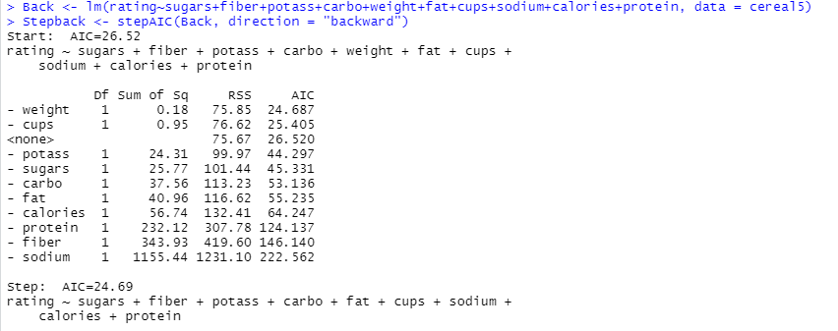
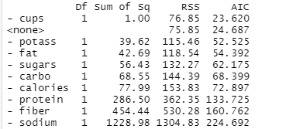

Slide 18
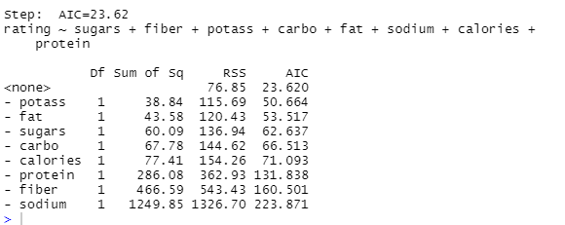
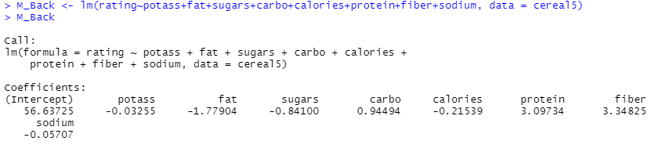


Slide 19

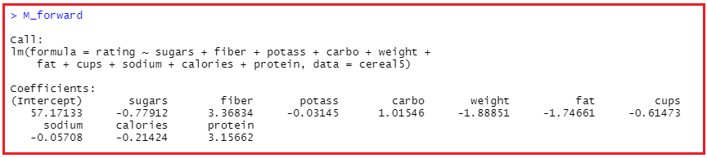


Slide 20
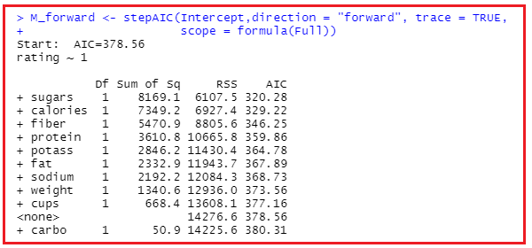

Forward Selection using AIC
Full model has all the variables, Intercept model has no variables. For forward selection, we start with the Intercept model and add in variables one at a time – at each stage entering in the variable that lowers the AIC the most.
Full <- lm(rating~sugars+fiber+potass+carbo+weight+fat+cups+sodium+calories+protein, data = cereal5)
Intercept <- lm(rating~1,data = cereal5)
M_forward <- stepAIC(Intercept, direction = "forward", trace = TRUE, scope = formula(Full))
Gives model a stopping point.
Note: trace = TRUE shows all the steps.

Slide 21
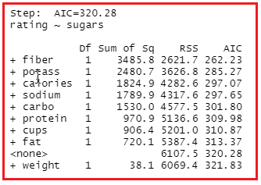
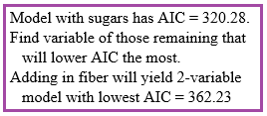
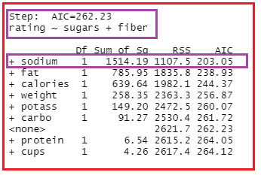

Steps 2 and 3

Slide 22
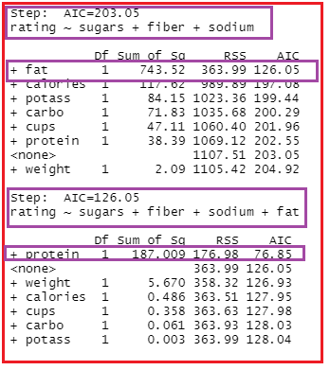
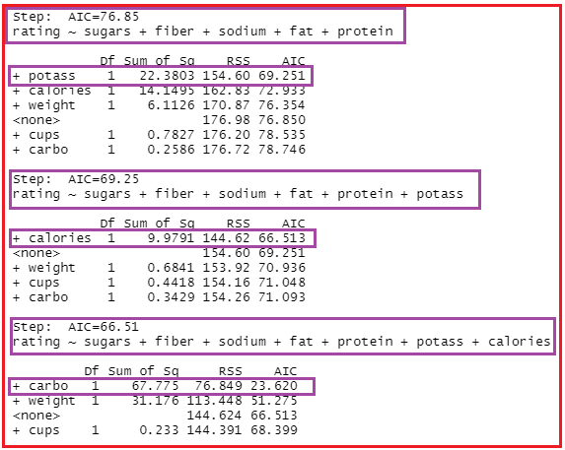
Steps 4 and 5 Steps 6, 7, 8

Slide 23
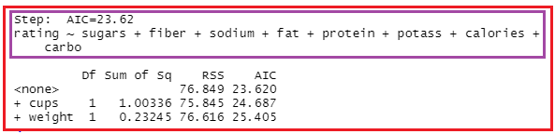

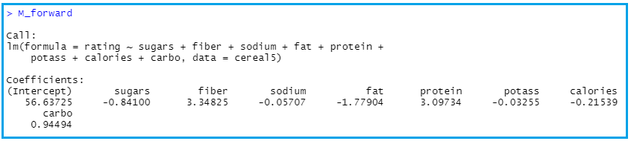
Step 9

Slide 24
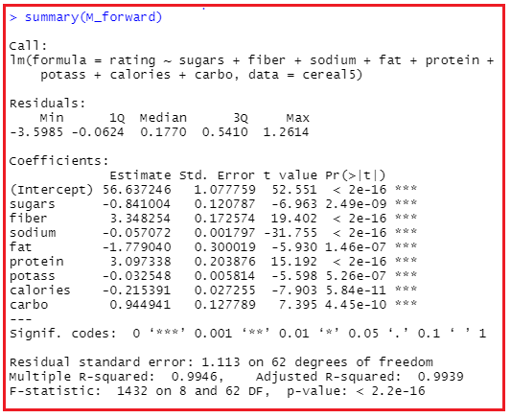

Slide 25
